Slide 1
Task 3.2
Refining Your Sitemap with Card Sorting
Minal Bombatkar

Slide 2
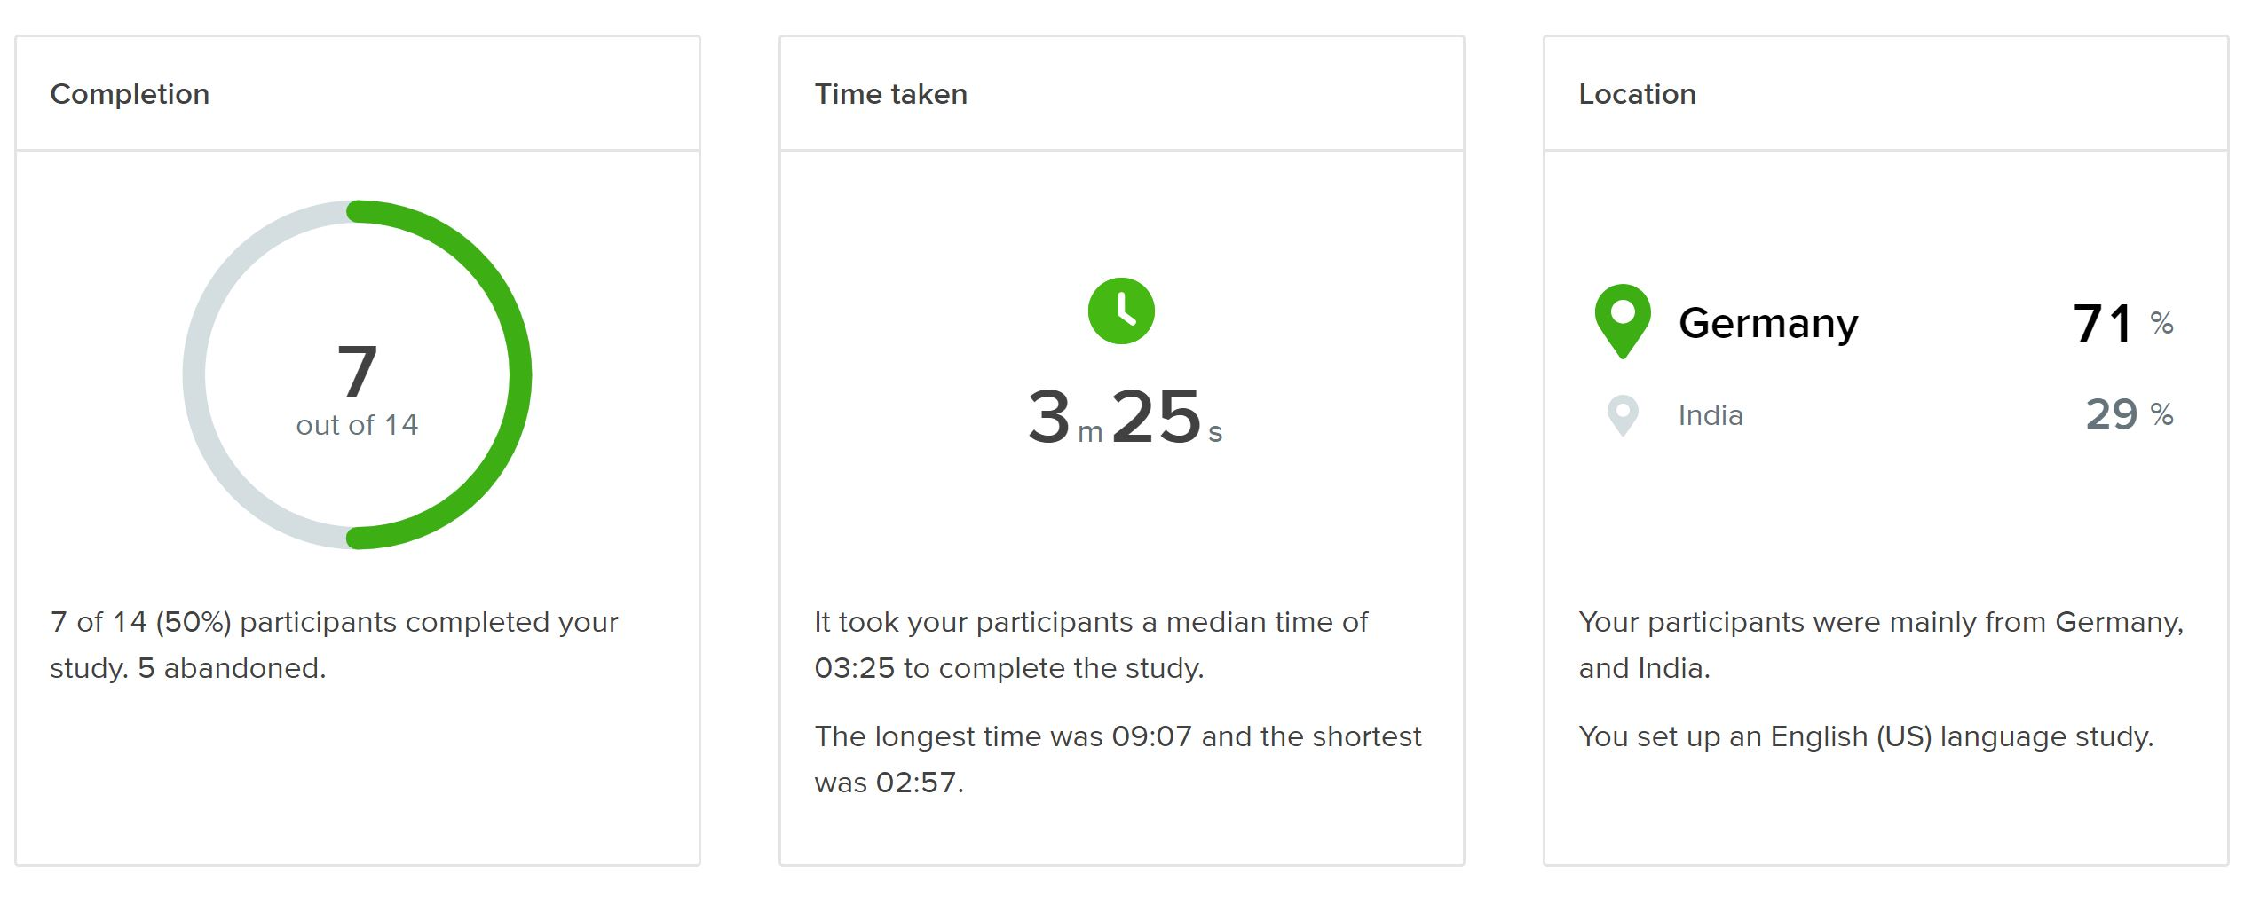
PARTICIPANTS
In total 7 out of 14 people finished card sorting and the 5 abandoned the test.
Majority of users doing the test were from Germany.
Most participants managed to finish the card sort under 10 minutes with an average of 3 minutes and 25 seconds.

Slide 3
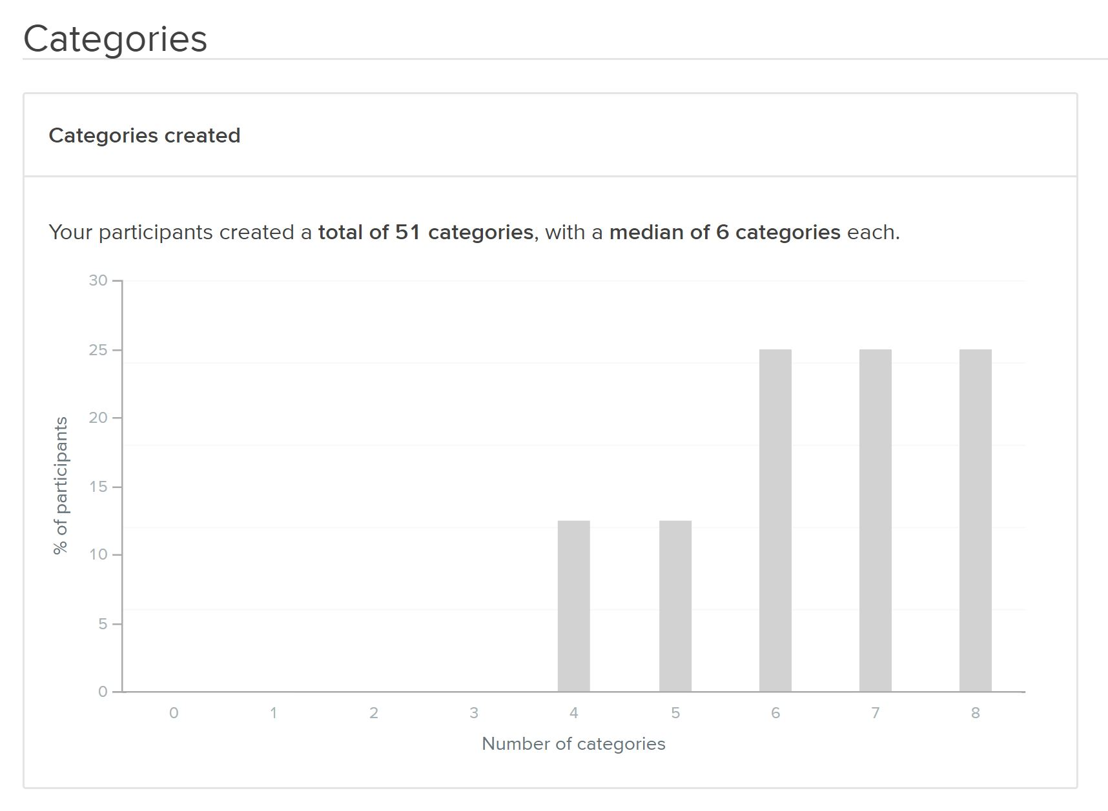
PARTICIPANTS
I decided to test my information architecture with a Hybrid card sort method and provided with 4 basic categories.
Participants created a total of 51 categories, with a median of 6 categories each.

Slide 4
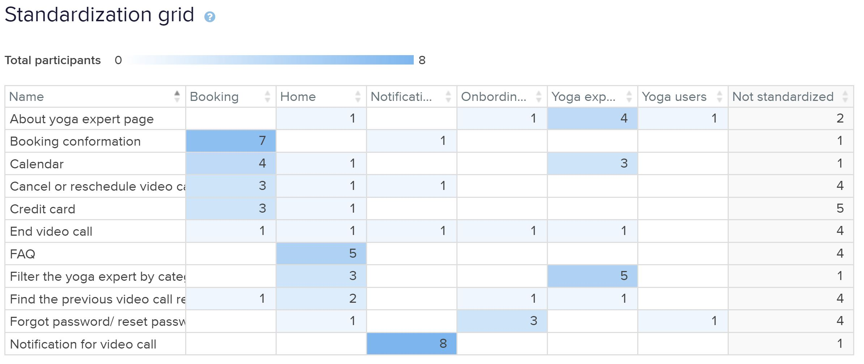
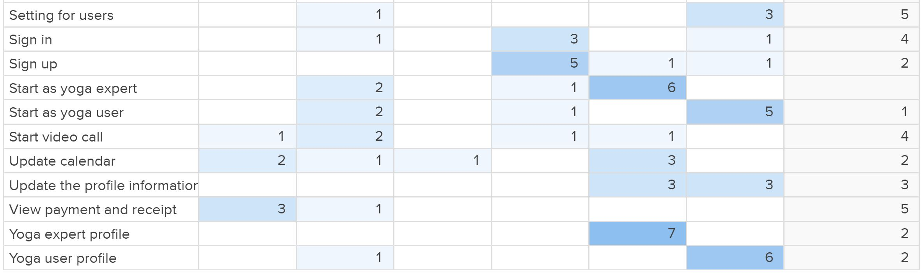
PARTICIPANTS
Many participants used their own naming
to categorise the groups, therefor
I needed to consolidated together similar groups based on their similarities.

Slide 5
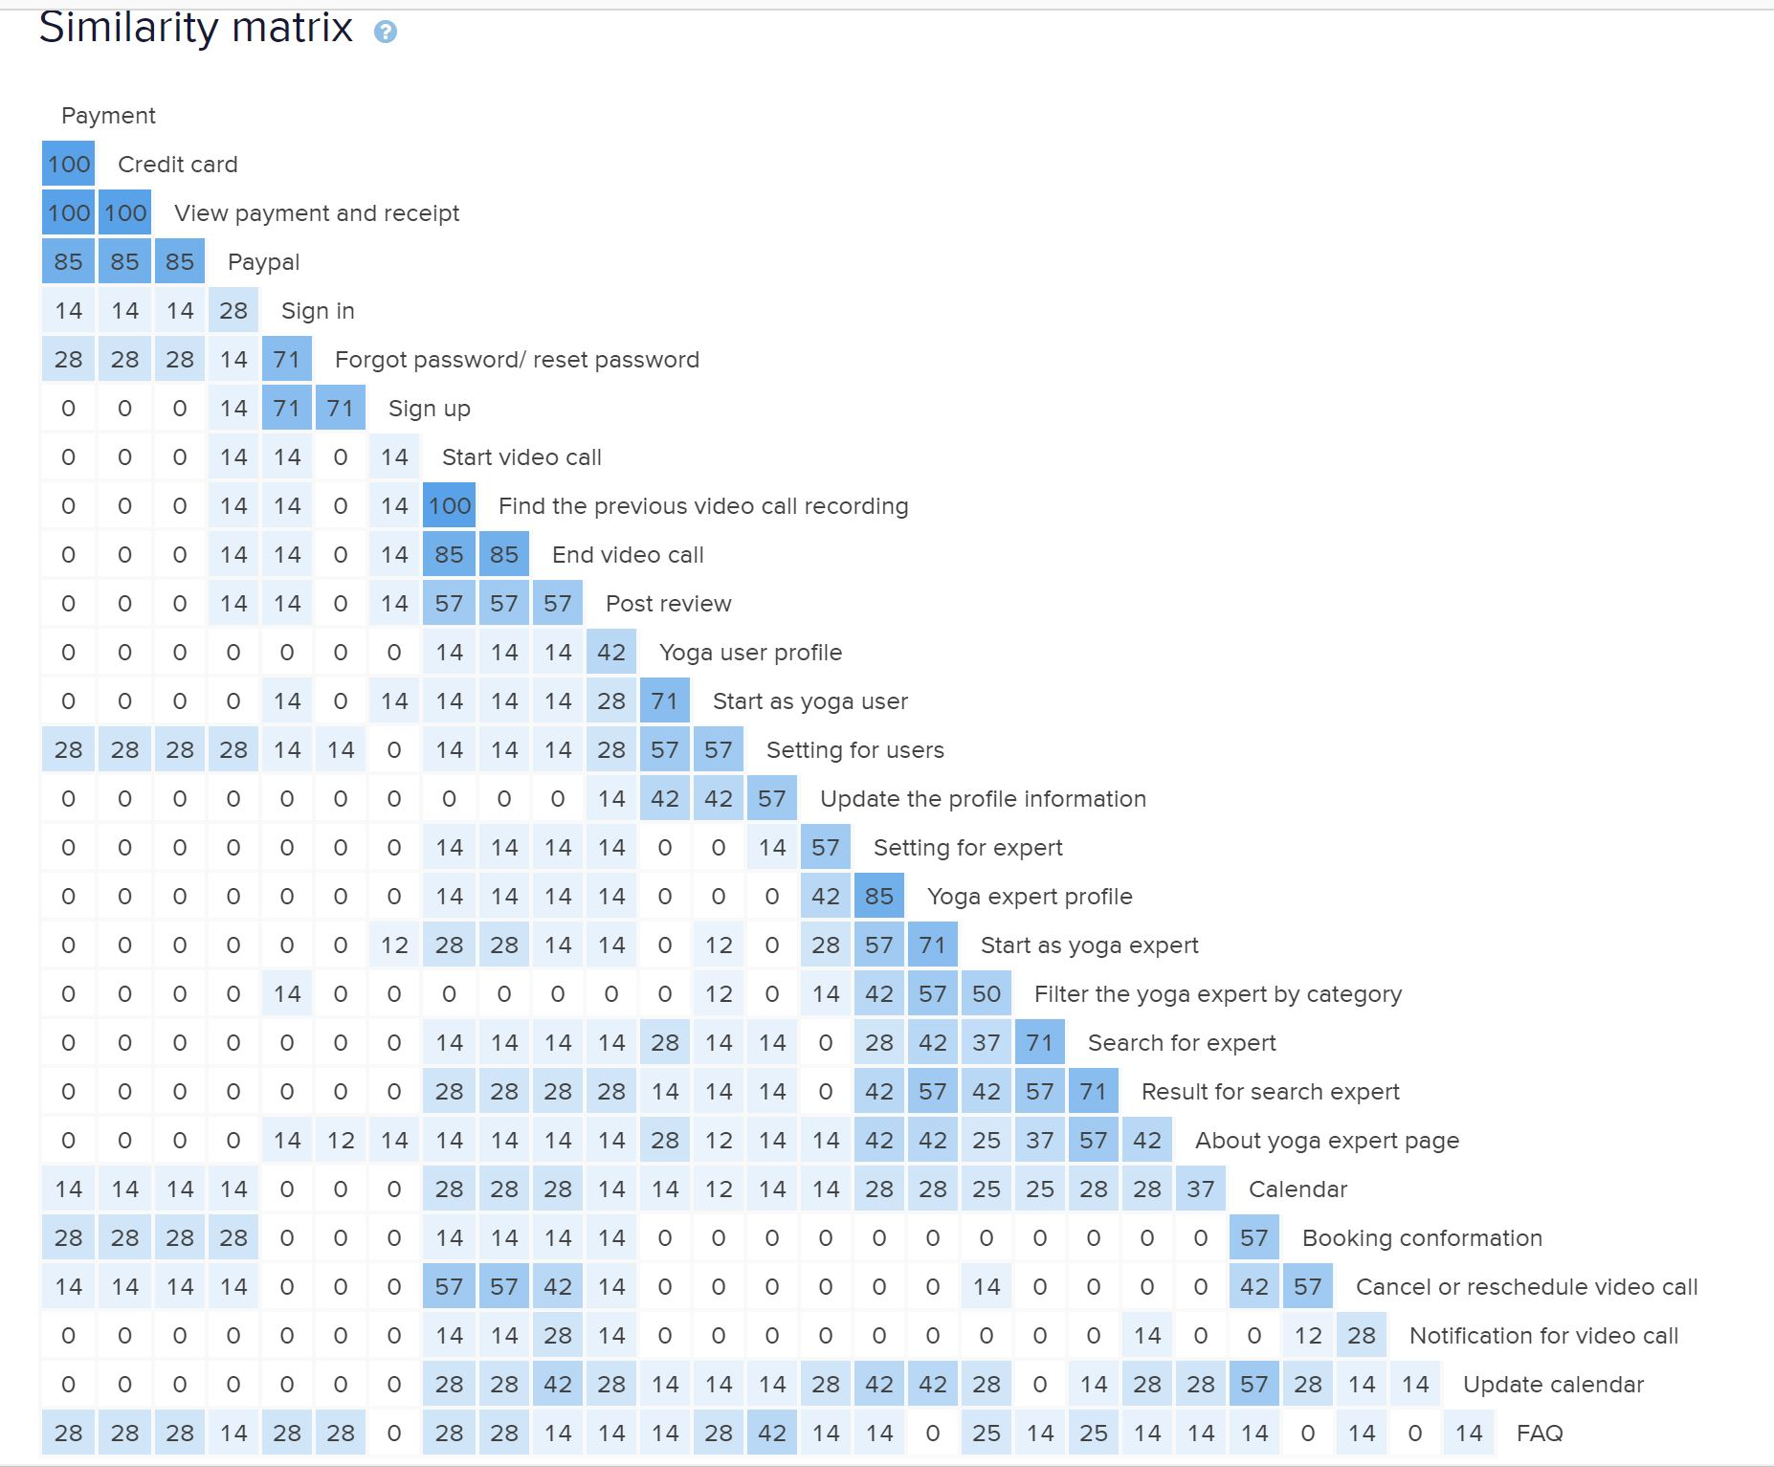
PARTICIPANTS
From similarity matrix,
it is clear that many groups come under similar category.

Slide 6
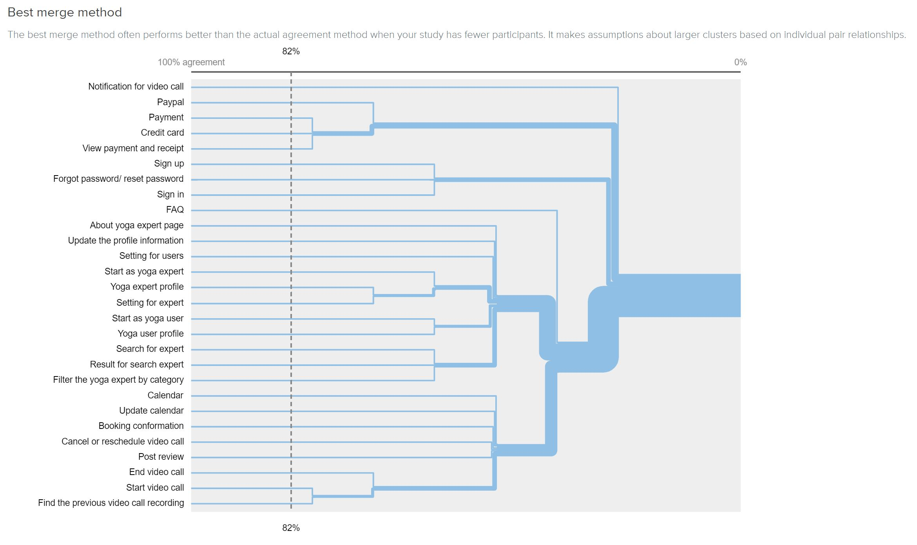
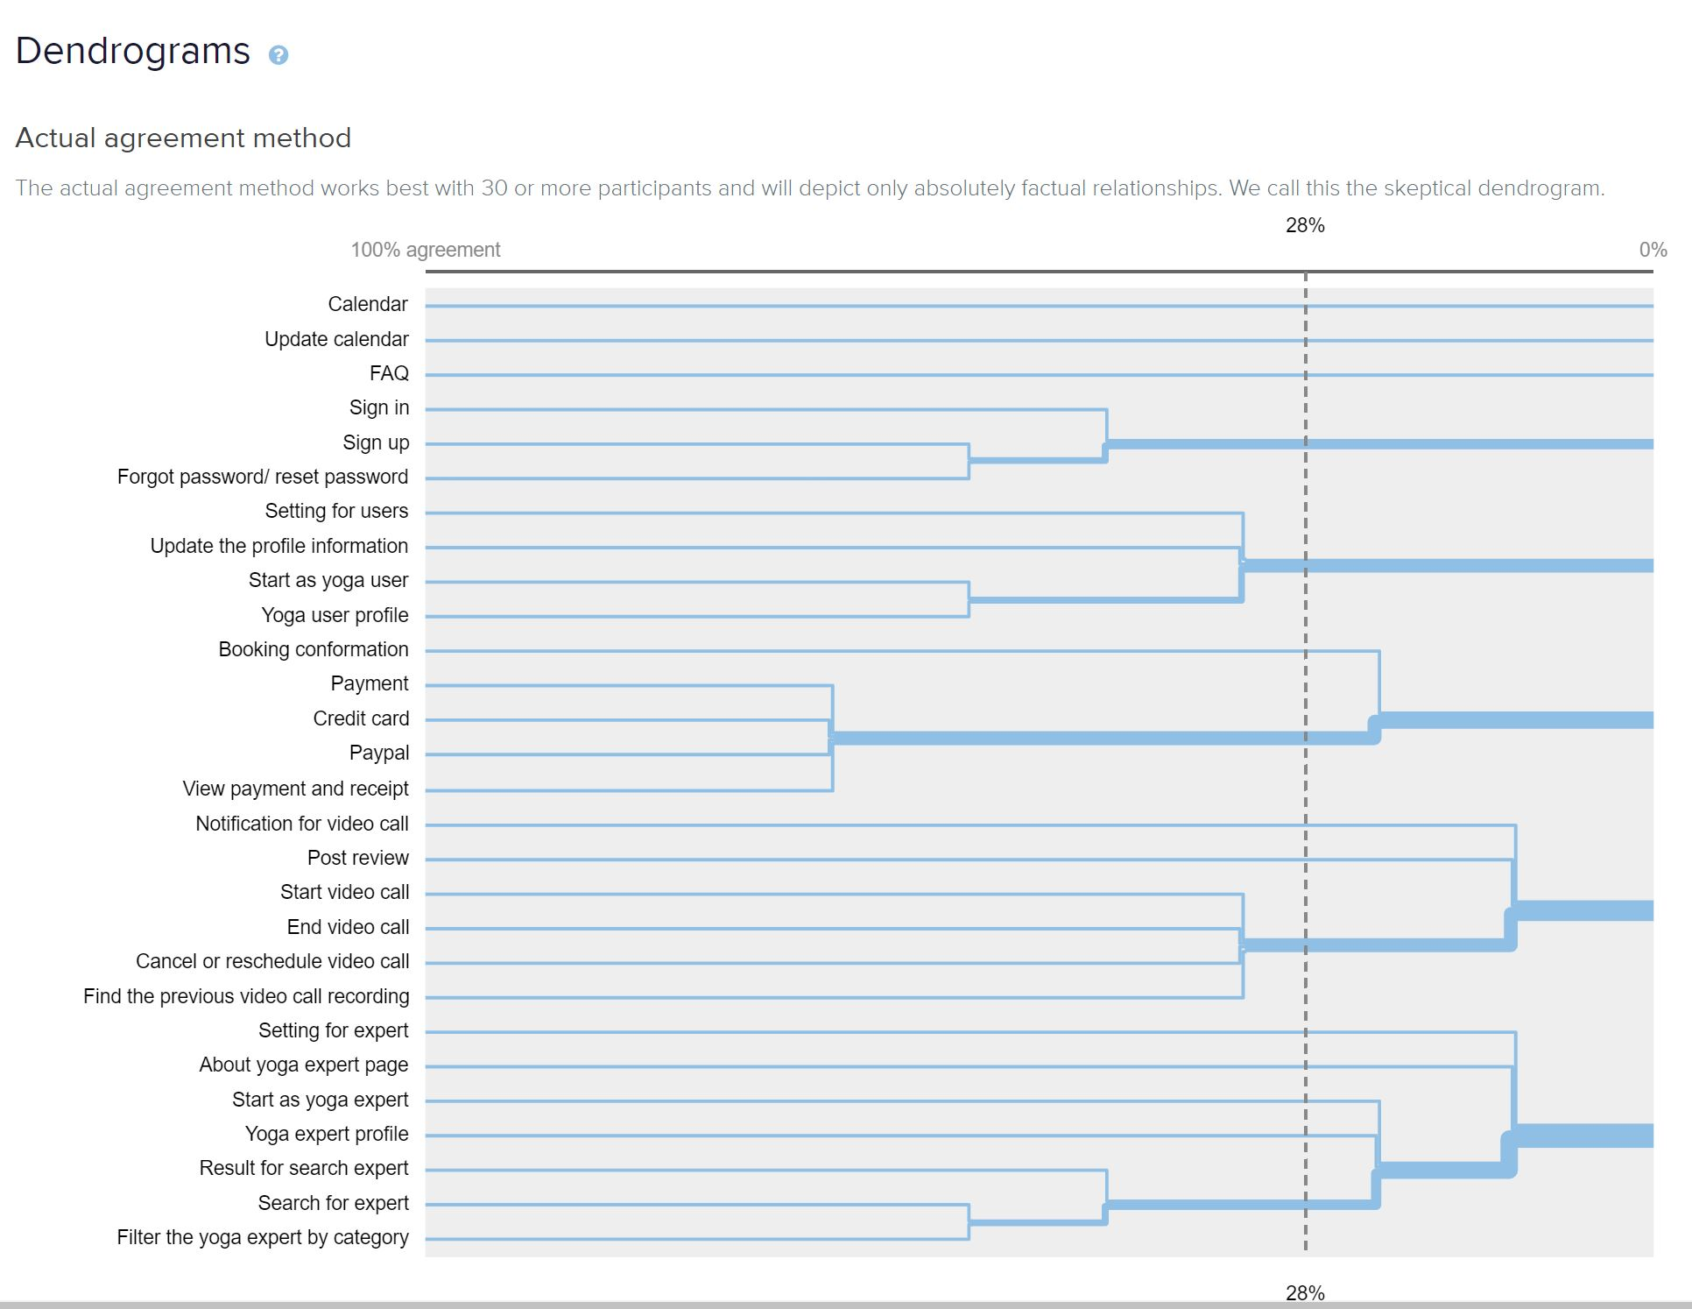
Dendrogram

Slide 7
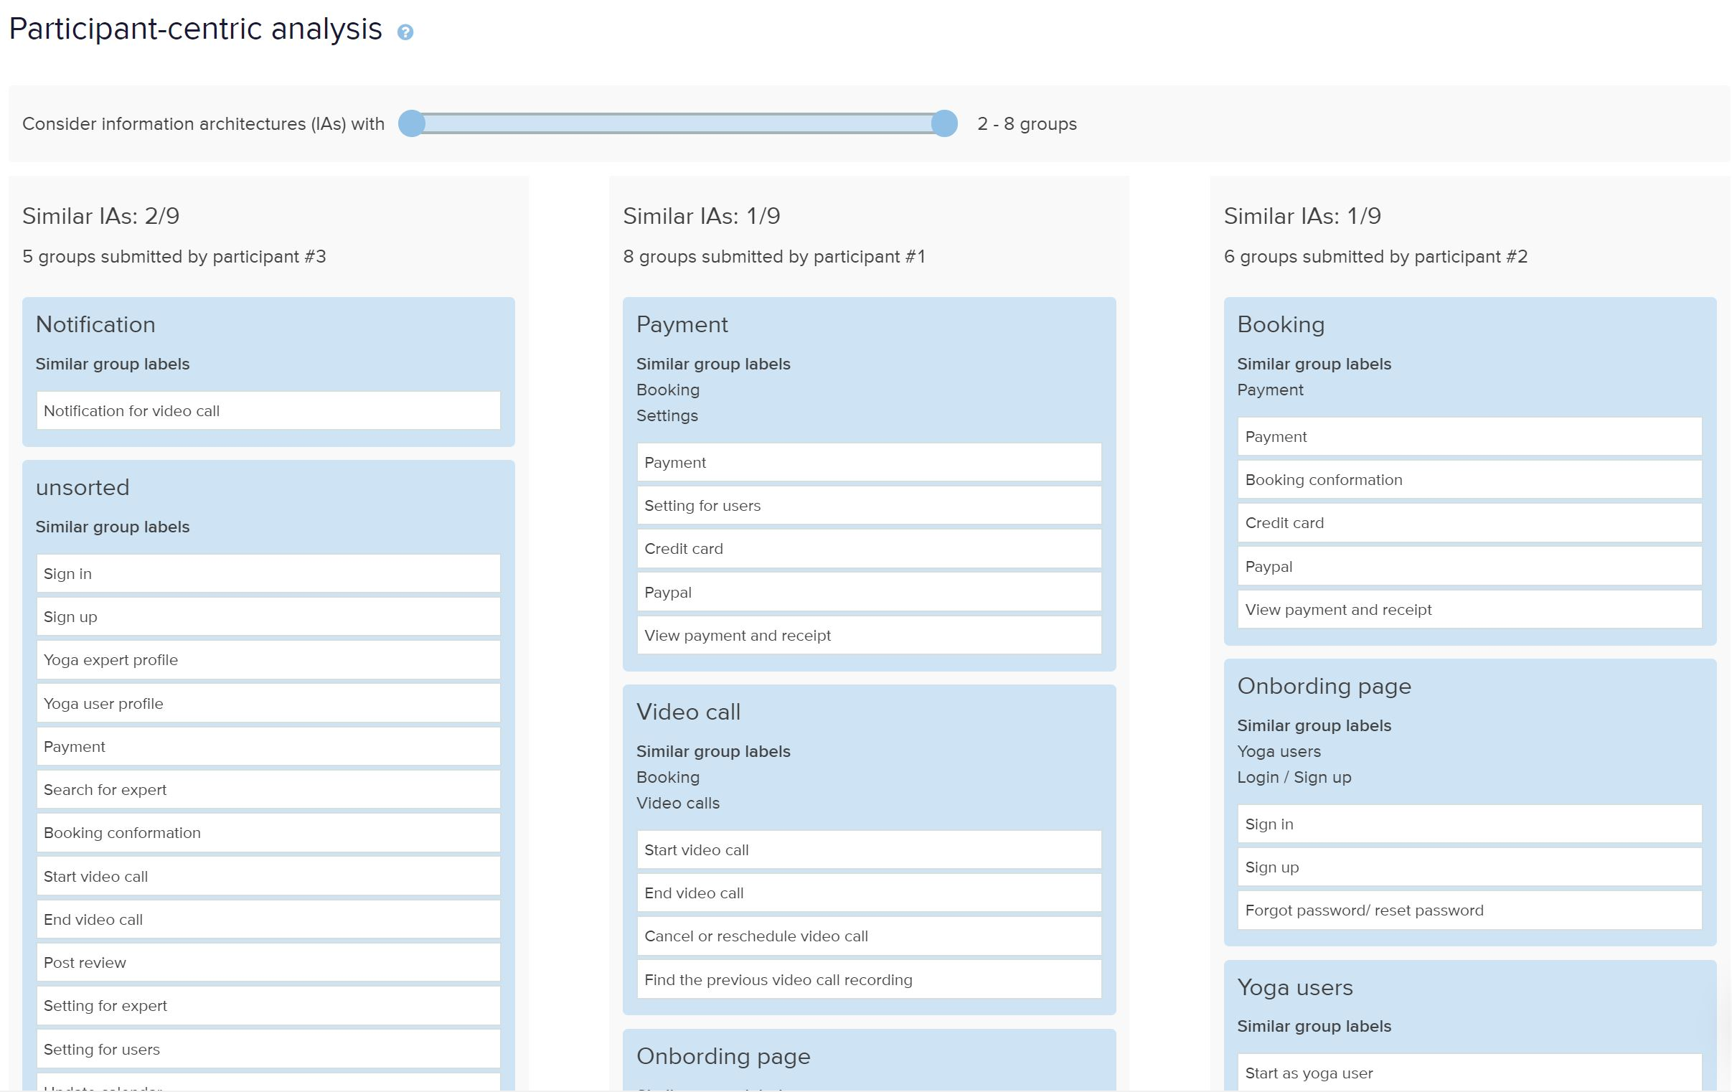
Participant centric analysis

Slide 8
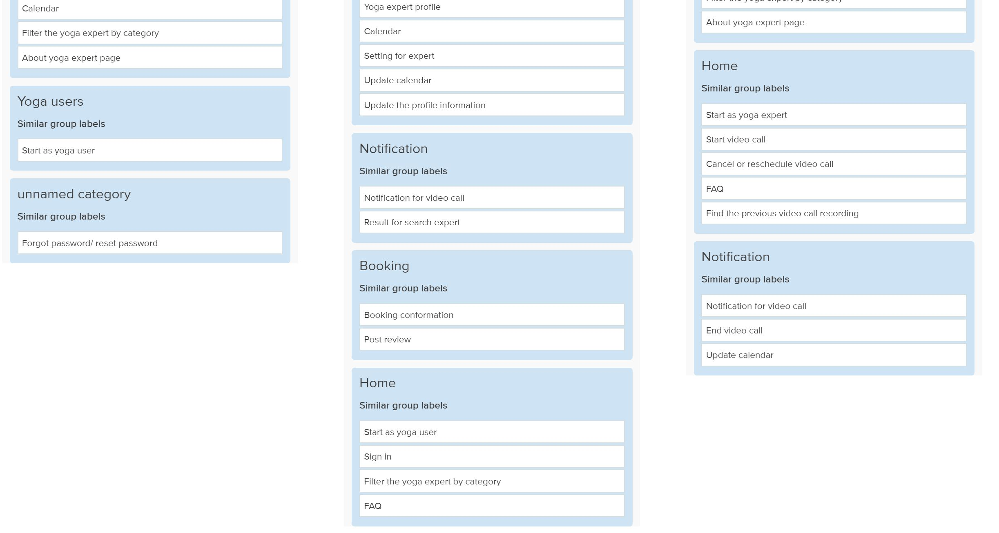
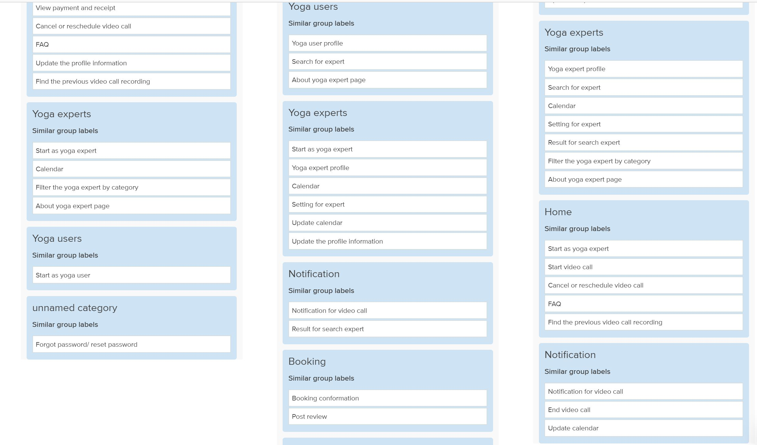
Participant centric analysis

Slide 9
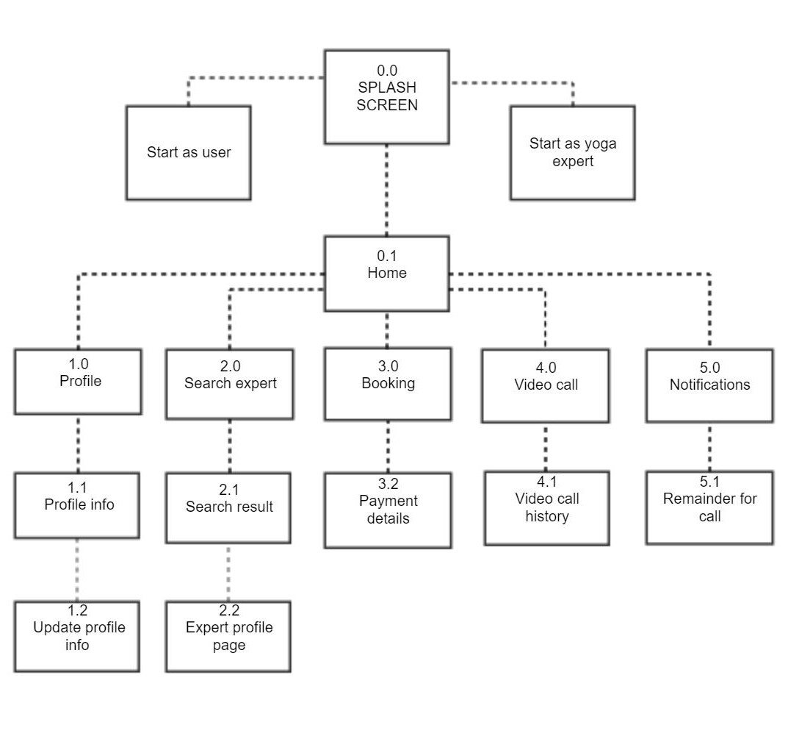
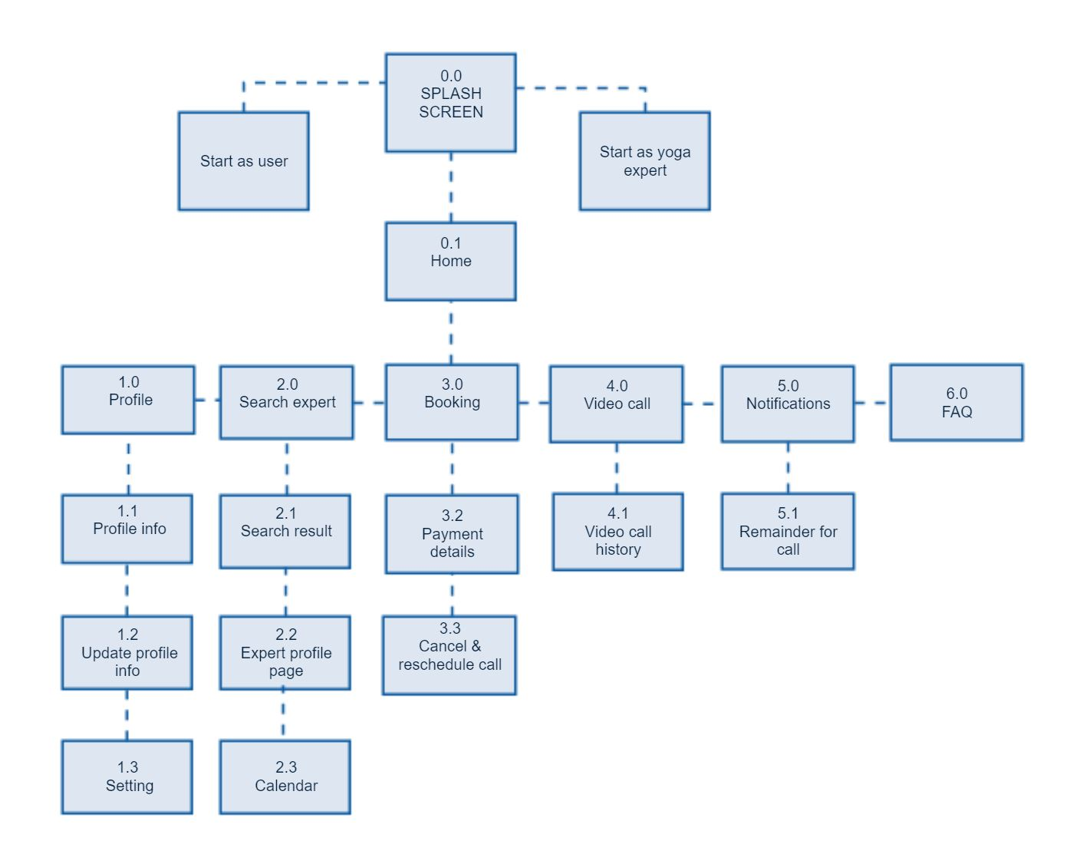
INITAIL SITEMAP
SITEMAP AFTER THE UPDATE

Slide 10
Conclusion
To a certain extent the users agreed with my initial site map.
But what I found from the data, many users named the categories really differently.
I had to combine the topics to get a better picture, I am glad to see that
the final categorisation is what I expected with some changes and requirement of new categories.
The sitemap got an improvement with added the page in the user profile section and I added FAQ category under Home page as the data showed. Also update site map for Booking with cancel and rescheduled call option and calendar is added under expert profile page.

